Slide 1
Adding Value to Our Community

Slide 2
ADDWC
Mission
To improve the quality of life for people with developmental disabilities and their families of Woodford County and the surrounding areas.
About Us
Small, non-profit agency providing quality, person-centered, individualized services to adults with intellectual disabilities

Slide 3
History
1950s: Woodford County parents became interested in organizing special education class similar to one that their children attended in Peoria at Neighborhood House sponsored by PARC.
Initial meeting held August 1955 that brought together county superintendents and parents
Parent’s group formed and to meet monthly: Woodford County Council for Mentally Retarded Children (WCC-MRC)
Members paid annual dues as well as raised money from community organizations and church groups
Approximately 15 parents were active in the first group

Slide 4
History
The first parent-sponsored class for trainable mentally handicapped children was started with six students on January 10, 1956
Eureka College offered classroom space and free utilities
Lunches were prepared at Davenport School and carried to the college
Parents provided transportation, solicited the public to donate materials, and paid the teacher’s salary
Mr. Dale Moore, County Superintendent of Schools, was instrumental in providing support to special education programs

Slide 5
History
1960: class was moved from Eureka College to Benson Junior High School and was supervised by Roanoke-Benson school district
December 1960: Moved near Metamora due to current building not meeting state code
February 1961: WCC-MRC joined the National Association for Retarded Children which helped keep informed on national and state legislation
April 1961: New organization formed “Opportunities, Unlimited” whose purpose was to provided worthwhile work and activity for adults with disabilities
Formed a newspaper recycling business in a semi-trailer

Slide 6
History
1963: WCC-MRC and Opportunities, Unlimited combined with hopes of establishing a more permanent workshop
1964: County Board of Supervisors voted to tax support the venture through the Mentally Deficient Persons Fund Board
Woodford became the 3rd county in the state to initiate a taxing fund
April 1965: Purchased American Legion Building. Top level was two classrooms and bottom level was the first sheltered workshop designated to recycling newspaper

Slide 7
History
1966: Purchased lot adjacent to Woodmore School with plans to build a new workshop and classrooms
1968: New workshop building was built and public school program expanded into entire Woodmore School building
1974: name change to Woodford County Council for Mentally Retarded Citizens
1986: adopted new by-laws; changed name to Woodford County Association for the Developmentally Disabled and formed a Board of Directors

Slide 8
History
BOD began meeting monthly and in 1987 created campaign to design new logo and changed name to the Association for the Developmentally Disabled of Woodford County.
ADD-WC in an effort to symbolize adding services for the developmentally disabled

Slide 9
History-Overview
Woodford County Board and 377 Board originally operated the training center into the 1980s
Group of parents felt Woodford County had fallen behind and more services should be offered
The initial Board of Directors began research on vocational, residential and recreational services
Information presented to 377 Board and request that money be spent on these services instead of the recycling program.
Much resistance by the county and 377 Board. However, after some Department of Labor violations in 1993, it was decided it was time to turn over operations to an agency
May 1994: ADDWC received 377 funding to establish certified programming to this population
Where are we today?

Slide 10
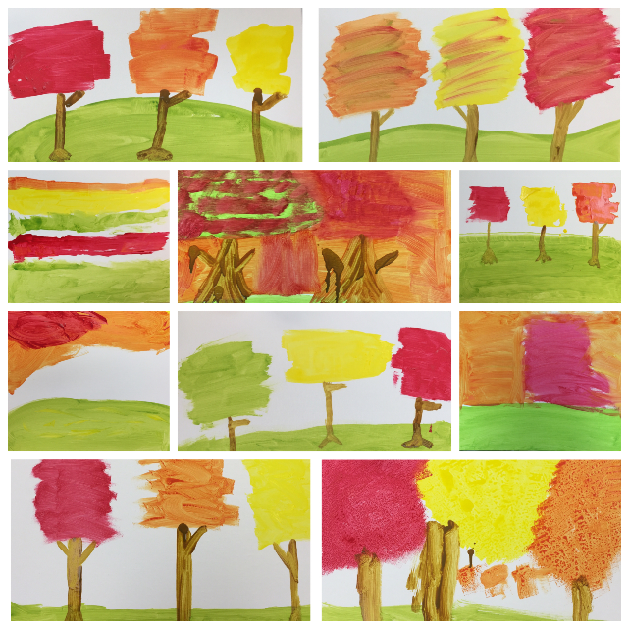
Services
Developmental Training
ADDWC provides training programs that teach employable skills through group instruction, demonstrations, and hands-on learning. Individuals are given the opportunity to utilize their abilities through our community recycling program.
Life Skills
This program teaches functional skills in both small group and one-on-one environments. Individuals are given the opportunity for growth in personal care, adult living skills, recreational and leisure experiences, financial management, artistic expression and social proficiency.

Slide 11
Recycling
A crew composed of vocational skills training program participants and ADDWC staff, operates routes to various businesses throughout Woodford County. ADDWC also monitors 24 hour drop off trailers in Metamora, Goodfield, Washburn and Minonk.
For more information, contact ADDWC at 467-3015 or visit www.addwc.org

Slide 12
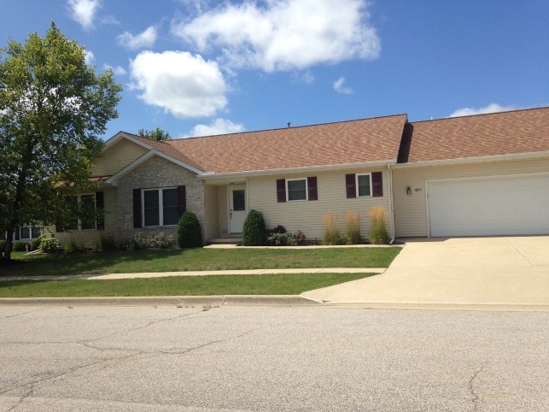
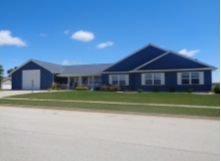
Community Living
ADDWC offers residential services which promote independent living and are based on an individual’s needs. Twenty-four hour support is offered in a small, group home setting (4-8 individuals).

Slide 13
Get Involved
To continue improving and increasing opportunities for adults with intellectual disabilities ADDWC needs your support.
To learn more about how you can Get Involved and support our mission you can:
Subscribe to our newsletter
“Like” us on Facebook
Follow us on Instagram
Learn more by visiting our website at www.addwc.org or contact us at addwc@mtco.com

Slide 14
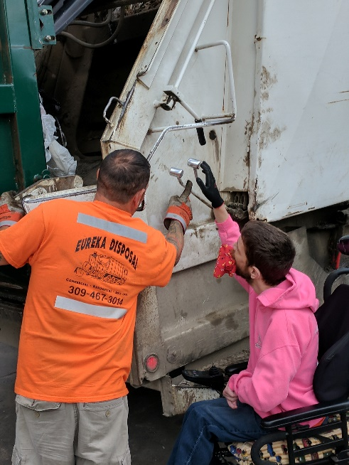
Fundraisers
Italian Feast Fundraiser
Held annually on the 1st Saturday in May at Eureka Bible Church
Event includes Dinner, Silent Auction and Raffle Items
Going Green Golf Fundraiser
Held annually on the 4th Wednesday of September at Metamora Fields
Event includes 18 Holes of Golf, Drinks, Lunch, Dinner and Prizes

Slide 15
Association for the Developmentally Disabled of Woodford County
200 Moody Street
Eureka, IL. 61530
Phone: 309-467-3015
Email: addwc@mtco.com
www.addwc.org

